Slide 1
Aung Myin Kyaw (Max) weekly Research Progress Report
Date : 29/09/2018 to 06/09/2018
Scope of the work:
Printing of the data to csv file and understanding the values

Slide 2
Research Progress in last week
This is week I was able to collect data into the csv file (the file is attached as ‘test1.csv). The code I used to collect data is attached in the following slide.
However, the data collected does not tally with the data I downloaded from Thorlabs which is attached as ‘testthorlabs.csv’. Thus, for the coming week I will be examining the representation of the values that are collected.
After analyzing both Thorlabs program and my own program I had realized that both have different integration time. Thorlabs has integration time of 2.33 second while my program I set it as 0.1 sec.

Slide 3
Research Progress in last week
Thus, I changed my program integration time to 2.33 sec which is the same as Thorlabs using the following code.
double set_integrationtime = 2.33, get_integrationtime = 0.00
CCS100.setIntegrationTime(set_integrationtime );
Console.Write(set_integrationtime + "\n");
CCS100.getIntegrationTime(out get_integrationtime );
Console.Write(get_integrationtime + "\n");
The above lines of code will set the integration time to 2.33 and get the integration time from the system to print it out. Printing out of the integration time is to ensure that the timing was set correctly.

Slide 4
Research Progress in last week
However, after I set the integration time to 2.33 second I was unable to do scanning and collect the data to csv file. There was an error whenever it reaches the collection of data line of code in the program, an error can be seen in the photo below.
I have tried to changed to other integration time there is still an error. I need to further examine the program to ensure it was not my line of codes error. This is because the error that throwing is from the main library which was written by Thorlabs.

Slide 5
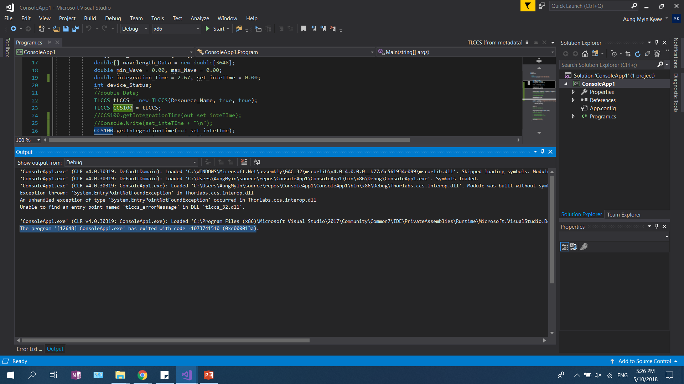

Slide 6
Research Plan for next week
Further examine the error that I am currently facing.
Start writing on the report for CA to be submitted on the Wednesday of Week 12 and for the presentation.
.

